Slide 1
Corporate Social Responsibility
Goodness is the only investment that never fails .

Slide 2
Introduction
The purpose of Corporate Social Responsibility (CSR) Web Application is to provide a portal for all companies who want to come up with a new scheme and get a place in industry.

Slide 3
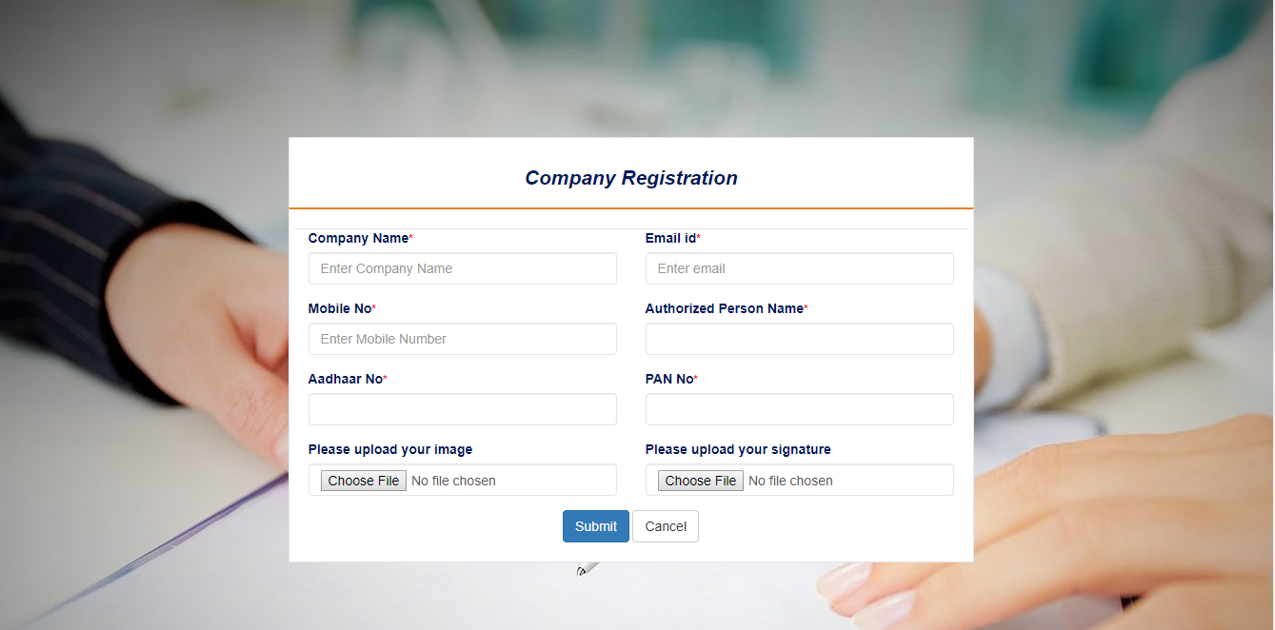
Company Registration

Slide 4
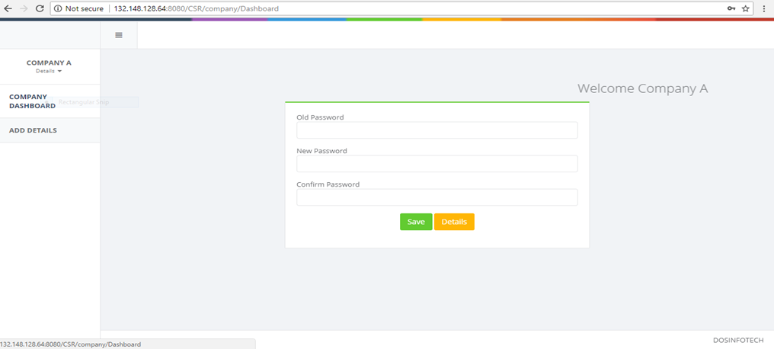
Company Dashboard

